Slide 1
Azure Workshop
Azure Fundamentals

Slide 2

Instructor
Mohd Mishal
Clouds Solution Architect
MCT since 2006
MCSA, MCSE, MCITP, MCSA
Azure, SCCM, O365
Computer Engineer UIUC

Slide 3
Workshop Schedule
Introduction to Cloud
Compute Instances
Web App
Virtual Networks
Azure Storage
Azure Databases
Active Directory in Azure
Microsoft Azure Fundamentals

Slide 4
Agenda
Time | Topic
9:00 AM | Introduction to Cloud
9:30 AM | Compute Instances
10:30 AM | Break
10:45 AM | Web Apps
11:30 AM | Virtual Networks
12:00 AM | Lunch Break
1:00 PM | Azure Storage
1:45 PM | Azure Databases
2:30 PM | Break
3:00 PM | Active Directory in Azure
4:30 PM | Q & A

Slide 5
Cloud Computing

Slide 6

Overview of cloud computing
Characteristics of cloud-computing solutions:
On-demand self-service
Broad network access
Resource pooling
Rapid elasticity
Measured service
Advantages of cloud computing:
Access to a broad range of managed services
Minimized or eliminated capital expenses
Lowered operational expenses
Usage-based billing model
Improved agility
Notes:
10979D
1: Getting started with Microsoft Azure

Slide 7
Cloud-computing models
A public cloud is an infrastructure, platform, or application service that a cloud service provider delivers for access and consumption by the public
A private cloud is a privately owned and managed cloud that offers benefits similar to those of a public cloud, but is designed and secured for use by a single organization
A hybrid cloud is a technology that binds two separate clouds—public and private—together for the specific purpose of obtaining resources from both
Notes:
10979D
1: Getting started with Microsoft Azure

Slide 8
Types of cloud services
Microsoft Azure
Office 365, Dynamics, VS Online, Intune, etc.
Windows Server + System Center (Server Platform)
Windows Server + Hyper-V +
Microsoft Azure
Physical
Virtual
IaaS
PaaS
SaaS
Notes:
Microsoft Office 365 is a good example of a SaaS offering. It is a fully functional, ready-to-use collection of software applications that are available from the cloud.
Azure Web apps and Azure SQL Database are good examples of a PaaS service. Both offer a platform for building custom applications and solutions, but do not require management at the operating-system level.
Note: Azure SQL Database sometimes is described as a Database-as-a-Service offering. This term represents a database-specific subset of PaaS solutions. Similarly, you might encounter terms such as Disaster Recovery-as-a-Service in reference to Azure Site Recovery or Identity-as-a-Service in relation to Azure Active Directory.
Azure Virtual Machines constitute a good example of an IaaS solution. They allow you to host Windows and Linux servers in the cloud and retain full control over their operating systems.
10979D
1: Getting started with Microsoft Azure

Slide 9
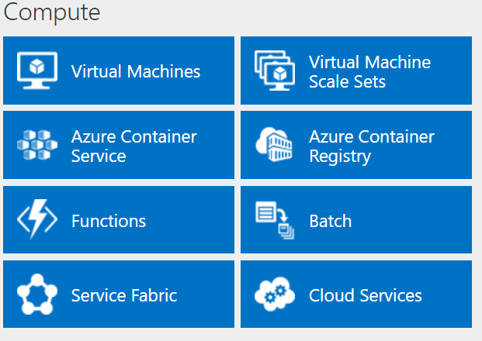
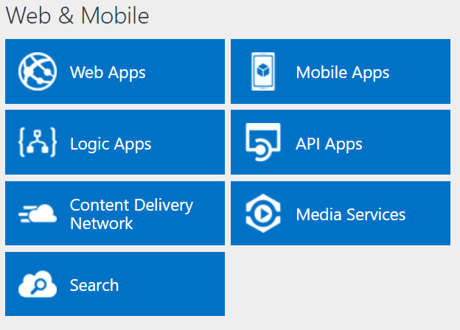
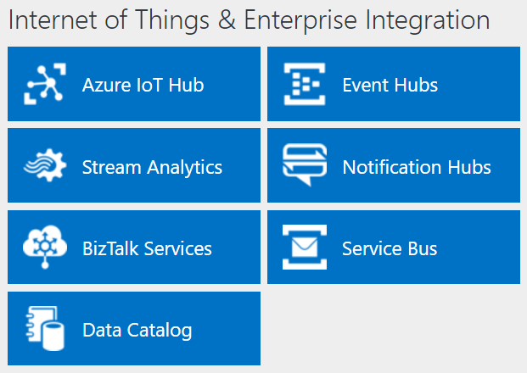
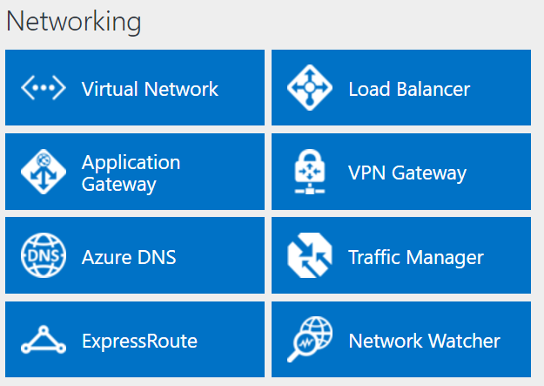
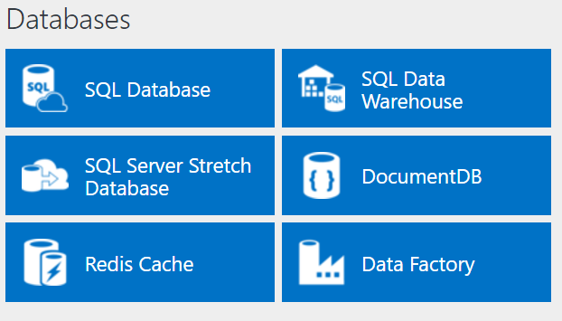
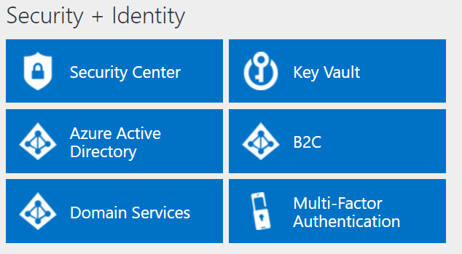
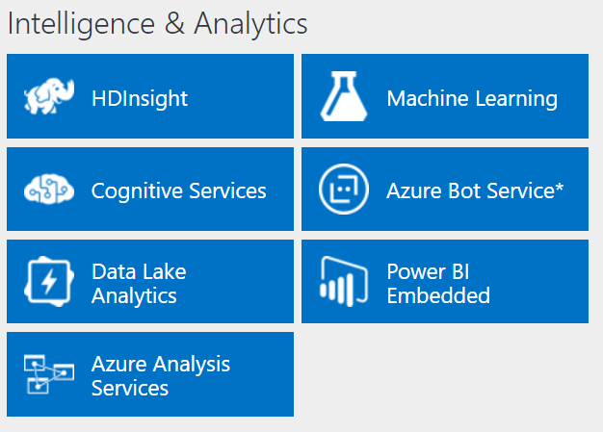
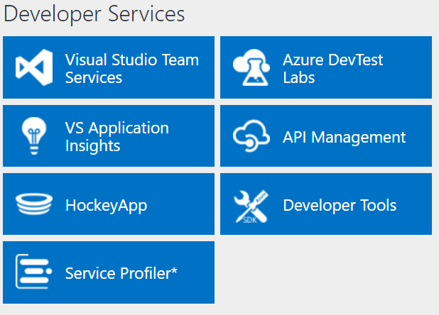
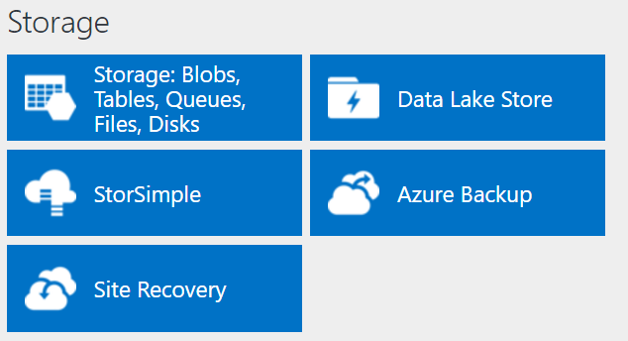
Azure services
http://azureplatform.azurewebsites.net/
* Preview Services
Notes:
Preview Version 1.7 (2017-04-20)

Slide 10
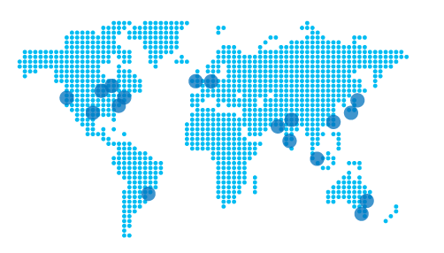
Azure services
Azure services allow you to:
Deploy and operate cloud-based applications
Host workloads in the cloud
Integrate cloud services with an on-premises infrastructure
Datacenter placement follows the principle of pairing
Notes:
10979D
1: Getting started with Microsoft Azure

Slide 11
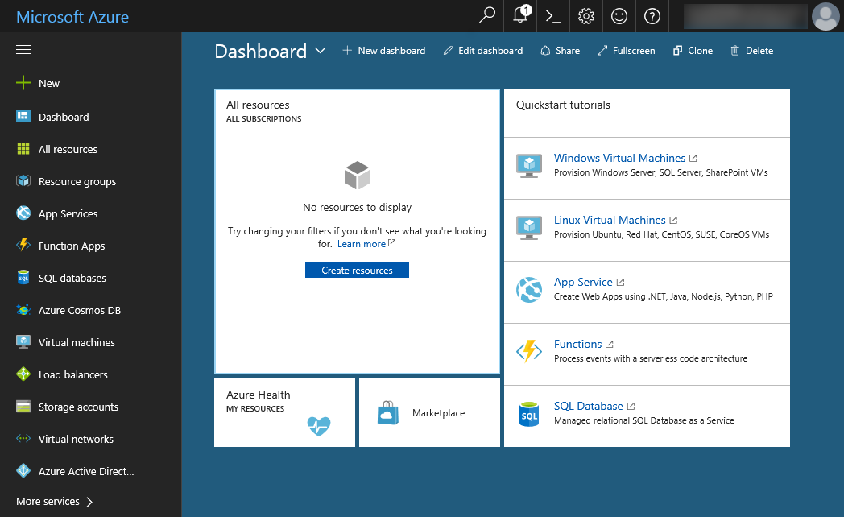
The Azure portal
Notes:
we will be sunsetting the Azure classic portal on January 8, 2018
10979D
1: Getting started with Microsoft Azure

Slide 12
Navigating the Azure portals

Slide 13
Client tools
Windows PowerShell with Azure PowerShell modules:
Run commands and scripts to manage Azure from Windows, Linux, OS X
Azure CLI:
Run commands and scripts to manage Azure from Windows, Linux, OS X
Visual Studio with Azure SDK for .NET:
Build solutions targeting Azure
Azure Cloud Shell:
Use command line interactively directly from within the Azure portal
Notes:
Describe different ways of interacting with Azure resources.
10979D
1: Getting started with Microsoft Azure

Slide 14
Azure pricing
No upfront costs
No termination fees
Pay only for what you use
Per minute billing
Notes:
10979D
1: Getting started with Microsoft Azure

Slide 15

Compute Instances

Slide 16
Creating and configuring VMs
What are Azure VMs? Create a VM by using the Azure portal Demonstration: Create a VM from the Azure portal by using an Azure Marketplace image Creating a VM from an Azure Resource Manager template Demonstration: Creating a VM from an Azure Resource Manager template Configuring VM availability Demonstration: Deploying VMs into an availability set by using the Azure portal Configuring an operating system by using VM extensions Connecting to a VM Demonstration: Connecting to a VM
Overview of virtual hard disks Overview of managed disks Azure VMs disk mobility Configuring storage in Windows and Linux VMs Demonstration: Configuring disks
Notes:
10979D
3: Virtual machines in Microsoft Azure

Slide 17
What are Azure VMs?
Use Azure VMs to:
Extend your datacenter to increase agility
Migrate your workloads from on-premises datacenters or from other cloud providers
Implement production, test, or development
Key differences when using Azure VMs:
Currently no support for Generation 2 Hyper-V VMs
Read-only VM console access
Cost calculated on per-minute basis:
Does not apply when VM is stopped (deallocated)
Does not include VM disks in Azure Storage
Notes:
Explain the main benefits of deploying VMs in Azure. Discuss some common scenarios. In addition, explain the differences between on-premises Microsoft Hyper-V VMs and VMs in Azure. Lastly, mention the method of calculating Azure VM charges.
There are additional slides for this topic.
10979D
3: Virtual machines in Microsoft Azure

Slide 18
Azure VM sizes
General purpose:
balanced CPU-to-memory ratio
A0-A7, Av2 series, D series, Dv2 series, DS series, DSv2 series
Compute optimized:
high CPU-to-memory ratio
Fs and F series
Memory optimized:
high memory-to-CPU ratio
D, Dv2, DS, DSv2, M, G, and GS series
Storage optimized:
high-performance disk I/O
Ls series
GPU:
Graphic Processing Unit support
NV and NC series
High performance compute:
fastest CPUs and optional high-throughput RDMA
H series and A8-A11
Notes:
Describe the categories of Azure VM sizes.
10979D
3: Virtual machines in Microsoft Azure

Slide 19

Azure VM Sizes
A
D
Dv2
G
Av2
Lowest Price
SSD Storage Fast CPUs
New generation of D family VMs
High memory and
Large SSDs
New A-Series
F
NC
NV
H
L
SAP
Compute Intensive
NVIDIA GPUs
K80 Compute
NVIDIA GPUs
M60 Visualization
Fastest CPU
IB Connectivity
Large SSDs
SAP Large Instances
Soon
Soon
Soon
Soon
ND
NCv2
Dv3
Ev3
Deep Learning
NVIDIA P40s
New gen of NC
NVIDIA P100s
New generation of D family
High memory

Slide 20
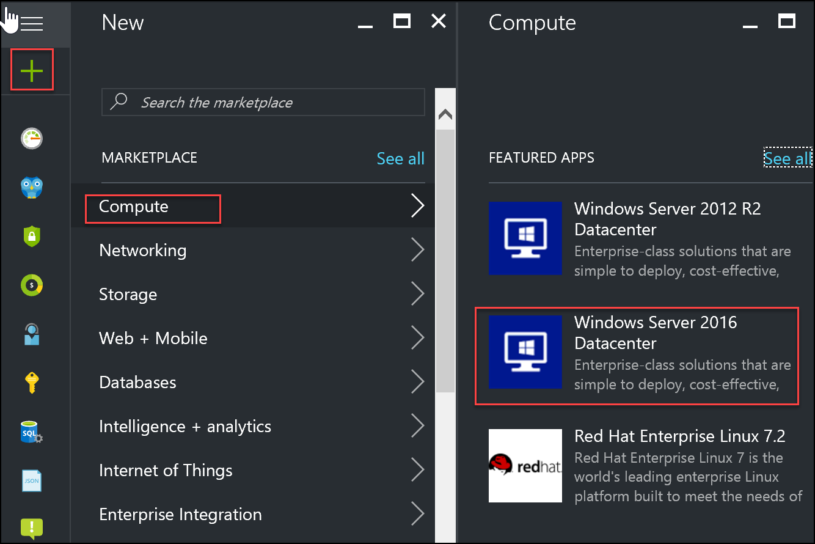
Using the Azure portal to create virtual machines
Notes:
The Azure Portal based experience:
VM name
VM disk type
User name and password
User name and SSH public key (Linux only)
Subscription
Resource group
Location
VM size
Storage (managed or non-managed disks)
Storage account (non-managed disks only)
Virtual network and subnet
Public IP address
Network security group
Extensions
Monitoring and the corresponding Diagnostics storage account
20533D
3: Implementing virtual machines

Slide 21
Create a VM from the Azure portal by using an Azure Marketplace image
Notes:
https://docs.microsoft.com/en-us/azure/virtual-machines/windows/quick-create-portal
https://docs.microsoft.com/en-us/azure/virtual-machines/linux/quick-create-portal

Slide 22
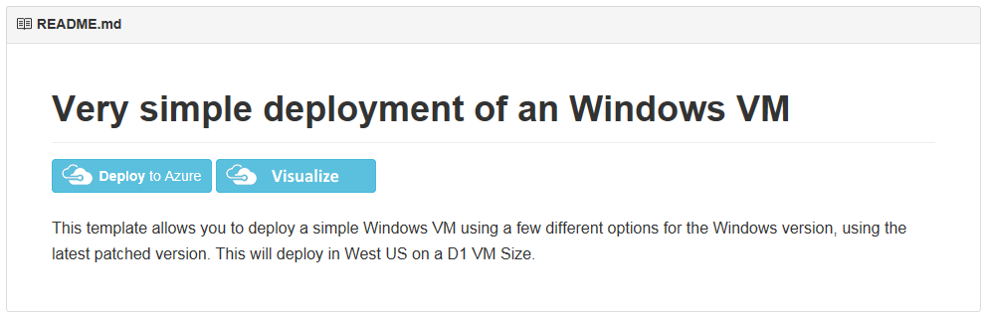
Creating a VM from an Azure Resource Manager template
Azure PowerShell:
New-AzureRmResourceGroupDeployment
Azure CLI:
az group deployment create
Azure portal:
New > Compute > Template deployment
GitHub (redirects to the Azure portal):
https://github.com/Azure/azure-quickstart-templates
Notes:
Describe the different methods of deploying Azure Resource Manager templates.
10979D
3: Virtual machines in Microsoft Azure

Slide 23
Creating a VM from an Azure Resource Manager template
https://github.com/Azure/azure-quickstart-templates/tree/master/101-vm-simple-windows
Notes:
High level demonstration steps
From the classroom VM, start Internet Explorer and browse to https://github.com/Azure /azure-quickstart-templates/tree/master/101-vm-simple-windows.
On the Very simple deployment of a Windows VM page, click Deploy to Azure.
On the Custom deployment blade, specify the following:
Subscription: Your subscription
Resource group: Create new
New resource group name: 10979D03-DemoRG03
Location: Azure region closest to the classroom location
Admin Username: Student
Admin Password: Pa55w.rd1234
Dns Label Prefix: Unique string consisting of lower-case letters and digits
Windows OS Version: 2016-Datacenter
Click I agree to the terms and conditions stated above.
Select the Pin to dashboard check box.
Click Purchase.
Note the Deployment started message in the notification area at the top of the page.
Do not wait for the deployment to complete. Continue with the next topic.

Slide 24
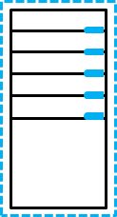
Configuring VM availability
Fault Domain 0
Fault Domain 1
Fault domain 0
Fault domain 1
Fault domain 2
Update
domain 0
Update
domain 4
Update
domain 3
Update
domain 1
Update
domain 0
Update
domain 4
Update
domain 2
Update
domain 1
Update
domain 0
Update
domain 3
Update
domain 2
Update
domain 1
Notes:
Use this slide to illustrate the distribution of VMs across fault domains and update domains.
There is an additional slide for this topic.
10979D
3: Virtual machines in Microsoft Azure

Slide 25
VM scaling
Vertical scaling:
Change individual VM size
Horizontal scaling:
Change number of VMs in the same availability set
On demand or scheduled
Azure Resource Manager model:
VM scale sets: automatically provisioned VMs
Classic model:
Preprovisioned VMs
Notes:
10979D
3: Virtual machines in Microsoft Azure

Slide 26
Deploying VMs into an availability set by using the Azure portal
https://docs.microsoft.com/en-us/azure/virtual-machines/windows/tutorial-availability-sets

Slide 27
Configuring an operating system by using VM extensions
VM Agent:
Included automatically in Marketplace images
You can add it to your custom VM images
VM extensions:
Background Info extension (Windows)
Azure VM Access extension for Windows and Linux
Chef Client and Puppet Enterprise Agent (Windows and Linux)
Custom Script extension for Windows and Linux
DSC extension for Windows and Linux
Azure Diagnostic extension for Windows and Linux
Docker extension (Linux)
Microsoft Antimalware extension (Windows)
Notes:
Briefly review the functionality that each extension provides. Explain that this is just a subset of all VM extensions available for Azure VMs.
10979D
3: Virtual machines in Microsoft Azure

Slide 28
Connecting to a VM
Windows VMs:
RDP:
User based authentication
Generate .rdp file from the portal or via Windows PowerShell
Incoming connections:
Allowed by default (when using the Azure Portal)
Windows Firewall rule
Network Security Group rule
Linux VMs:
SSH:
User based or certificate based authentication
Use an SSH client
Incoming connections:
Allowed by default (when using the Azure Portal)
Network security group rule
Notes:
Describe the two primary methods of connecting to Windows and Linux Azure VMs.
10979D
3: Virtual machines in Microsoft Azure

Slide 29
Connecting to a VM
https://docs.microsoft.com/en-us/azure/virtual-machines/windows/connect-logon

Slide 30
Configuring disks
Overview of virtual hard disks Overview of managed disks Azure VMs disk mobility Configuring storage in Windows and Linux VMs Demonstration: Configuring disks
Notes:
10979D
3: Virtual machines in Microsoft Azure

Slide 31
Overview of virtual hard disks
Azure VM
C:\
operating system disk
D:\
Temporary disk
(contents can be
lost)
F:\Data disks
Azure blob
Notes:
Remind the students about virtual disks. Most of them will probably know about the virtual disks that Hyper‑V uses. If that is the case, you can focus on virtual disks that Microsoft Azure supports.
Explain the basics of Azure VM disk structure and how Azure stores VM disks.
10979D
3: Virtual machines in Microsoft Azure

Slide 32
Overview of managed disks
Non-managed disks:
Up to 200 Storage accounts per region
Up to 40 disks per Standard storage account
Storage accounts for VMs in the same availability set might be in the same stamp
A custom image in the same Storage account as VM disks
Managed disks:
Up to 10,000 disks per region
Storage account performance limits not relevant
Disks of VMs in the same availability set in different stamps
A custom image in the same region
Notes:
Compare and contrast nonmanaged disks and managed disks.
10979D
3: Virtual machines in Microsoft Azure

Slide 33
Azure VMs disk mobility
Azure virtual disk files:
.vhd format (.vhdx not supported)
Fixed type (dynamic not supported)
4-TB maximum size (use multidisk volumes if needed)
Azure virtual disk mobility:
Upload and download
Add-AzureRmVHD and Save-AzureRmVHD
az storage blob upload and az storage blob download
Attach and detach
Add-AzureRmVmDataDisk and Remove-AzureRmVMDataDisk
azure vm disk attach-new and azure vm disk detach
Azure Portal
Import/Export service (for larger disk sizes)
Azure virtual disk files copy and snapshot:
Managed and non-managed disks (full snapshots only)
Notes:
Describe cross-premises and Azure-only scenarios that involve disk copy, attach, detach, and snapshot operations.
10979D
3: Virtual machines in Microsoft Azure

Slide 34
Configuring storage in Windows and Linux VMs
The multi-disk management tools as on-premises:
Server Manager (Windows Storage Spaces)
Windows PowerShell (Windows Storage Spaces)
LVM (Linux)
mdadm (Linux)
Multi-disk volumes considerations:
Aggregate I/O throughput
Support for volumes larger than 4-TB disk size limit
Maximum number of data disks depends on VM size
Notes:
Depending on the students’ preference, focus on Storage Spaces–based Windows multidisk configuration or on Logical Volume Manager (LVM)/mdadm multidisk configuration on Linux.
Point out that, in either case, the steps to configure a multidisk volume are identical to those for on-premises computers.
10979D
3: Virtual machines in Microsoft Azure

Slide 35
Configuring disks
Notes:
High level demonstration steps
From the classroom VM, start Internet Explorer and browse to the Azure portal. If prompted, sign in by using the Microsoft account that is the Service Administrator of your Azure subscription.
Navigate to the 10979D03DemoVM1 blade.
Add two standard storage managed disks, each with a size of 128 GB.
Switch back the Remote Desktop session to 10979D03DemoVM1.
On 10979D03DemoVM1, create a new simple volume by using both disks with default settings.
Wait until the volume is fully formatted.
Close the RDP connection.
Delete all resource groups that you created in this module.
Close all open windows on the classroom VM.
Preparation Steps
Make sure you completed the previous demonstrations in this module.

Slide 36
https://github.com/MicrosoftLearning/10979-MicrosoftAzureFundamentals/blob/master/Instructions/10979D_LAB_03.md
Estimated Time: 30 minutes

Slide 37
Web Apps

Slide 38
Creating and configuring web apps
Web Apps as a component of Azure App Service Comparing the Web Apps feature, Azure VMs hosting web sites, and Azure Cloud Services Creating and maintaining web apps Configuring and scaling web apps Demonstration: Creating and configuring a web app
Notes:
10979D
4: Web Apps and cloud services

Slide 39
Web Apps as a component of Azure App Service
App Service:
Web Apps
Mobile Apps
API Apps
Logic Apps
Web Apps features:
Marketplace-based solutions
Autoscaling
Continuous integration
Deployment slots
Azure WebJobs
Hybrid connections
Notes:
Describe the types of App Service apps and summarize the most prominent features of Web Apps.
10979D
4: Web Apps and cloud services

Slide 40
Web Apps
Web Apps concepts:
Gallery applications
Autoscaling
Continuous integration and deployment
Deployment slots
Testing in production
Azure WebJobs
Hybrid connections
Azure virtual network integration
Authentication and authorization
Notes:
Provide an overview of the Web Apps feature of App Service. Explain that later lessons provide more detail about web apps.
20533D
5: Implementing Azure App Service

Slide 41
Mobile Apps
Requirements of mobile apps:
Store and access structured data
Receive notifications for alerts and updates
Authenticate and authorize
Incorporate business logic
Mobile Apps is not the same as Azure Mobile Services
You can move mobile apps from Mobile Services to Mobile Apps by using:
Migration
Upgrade
Notes:
Emphasize that the goal of that integration is to allow developers to use the same tools and platforms to develop mobile apps and web apps. Additionally, point out that Lesson 6 covers Mobile Apps in detail.
20533D
5: Implementing Azure App Service

Slide 42
Logic Apps
Logic apps integrate apps by using connectors:
Core connectors:
Office 365 Connector
Microsoft OneDrive Connector
Yammer Connector
Facebook Connector
HTTP Connector
Enterprise integration connectors:
SAP
Oracle
DB2
Informix
Notes:
If time permits, demonstrate how to create a logic app. Explain that developers can implement their own application programming interfaces (APIs) and develop solutions that will integrate with cloud-based apps.
20533D
5: Implementing Azure App Service

Slide 43
API Apps
Features of API Apps:
Visual Studio integration
Consumption model
Bring your existing API
Support for Swagger metadata
Support for cross-origin resource sharing
Triggering actions
Notes:
Describe the main components of the API Apps feature of Azure App Service.
20533D
5: Implementing Azure App Service

Slide 44
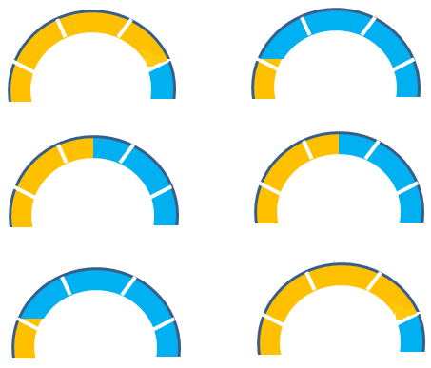
Comparing the Web Apps feature, Azure VMs hosting web sites, and Azure Cloud Services
If you want to host a web application in Microsoft Azure, you can choose to use virtual machines, web apps, or cloud services
Ease of use Control
- + - +
- + - +
- + - +
Web Apps
Cloud Services
Virtual Machines
Notes:
Describe the differences between web apps, cloud services, and virtual machines.
10979D
4: Web Apps and cloud services

Slide 45
Managing App Service plans
Tier | Free | Shared | Basic | Standard | Premium | Premium V2 | Isolated
Websites | 10 | 100 | Unlimited | Unlimited | Unlimited | Unlimited | Unlimited
Storage | 1 GB | 1 GB | 10 GB | 50 GB | 250 GB | 250 GB | 1 TB
Compute instance | Shared | Shared | Dedicated | Dedicated | Dedicated | Dedicated | Dedicated
Custom domains | No | Yes | Yes | Yes | Yes | Yes | Yes
SSL for custom domains | No | No | Yes | Yes | Yes | Yes | Yes
Integrated load balancer | No | Yes | Yes | Yes | Yes | Yes | Yes
AlwaysOn | No | No | Yes | Yes | Yes | Yes | Yes
Staged publishing | No | No | No | Yes | Yes | Yes | Yes
SLA | None | None | 99.95% | 99.95% | 99.95% | 99.95% | 99.95%
Notes:
Describe the features of each pricing tier and point out that the features are cumulative, which means that each plan has all the features of the lower tier plan plus additional features.
20533D
5: Implementing Azure App Service

Slide 46
Configuring and scaling web apps
General (frameworks, managed pipeline, platform, web sockets, Always On)
Auto swap
Debugging (VS 2012 and newer)
App settings
Connection strings
Default documents
Handler mappings
Virtual applications and directories
WebJobs
Scaling up: increasing a pricing tier
Scaling out:
Free and Shared. Not supported (but you can scale them up)
Basic. Manual (instance size, instance count)
Standard and Premium. Automatic (instance size, instance count, and autoscaling)
Notes:
Describe the main configuration options of web apps.
10979D
4: Web Apps and cloud services

Slide 47
Implementing WebJobs
WebJobs are scripts that run:
Continuously
Triggered
Scheduled
Manual
WebJobs can be:
Batch files (.cmd, .bat)
PowerShell scripts (.ps1)
Bash shell scripts (.sh)
PHP scripts (.php)
Python scripts (.py)
Node.js JavaScripts (.js)
JavaScript (.jar)
Notes:
Describe different types of WebJobs and different scripting languages that you can use to define their operations.
Point out that is no longer necessary to store scripts in .zip files before uploading them to Azure web apps via the Azure portal.
20533D
5: Implementing Azure App Service

Slide 48
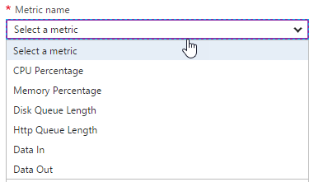
Design for Scalability and Performance
Scale Up – Change pricing tiers: Free, Shared, Basic, Standard, Premium
Scale Out – Change instance count: manually, auto
Scaling condition rules: Scheduled or Metric
Can have multiple condition rules
Can notify via email or webhook when autoscale events occur
Notes:
Design Web Apps for Scalability and Performance
Scale up an app in Azure
https://docs.microsoft.com/en-us/azure/app-service-web/web-sites-scale
Scale instance count manually or automatically
https://docs.microsoft.com/en-us/azure/monitoring-and-diagnostics/insights-how-to-scale?toc=%2fazure%2fapp-service-web%2ftoc.json

Slide 49
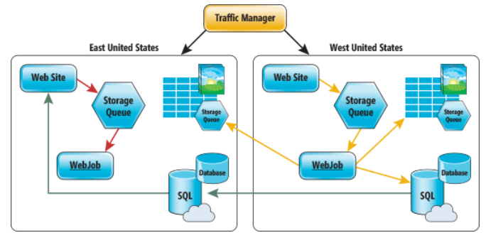
Deploy Azure Web Apps to Multiple Regions
Traffic Manager for routing traffic between regions
Performance – for directing user to closest region Failover – for secondary site Round Robin – for balancing traffic
CDN
Places static content close to user (images, media, etc)
Notes:
Deploy Azure Web Apps to Multiple Regions for High Availability
Controlling Azure web app traffic with Azure Traffic Manager
https://docs.microsoft.com/en-us/azure/app-service-web/web-sites-traffic-manager
Add a Content Delivery Network (CDN) to an Azure App Service
https://docs.microsoft.com/en-us/azure/app-service-web/app-service-web-tutorial-content-delivery-network
Best Practices: Windows Azure Websites (WAWS)
https://azure.microsoft.com/en-us/blog/best-practices-windows-azure-websites-waws/

Slide 50
Using Kudu
Kudu:
Provides Git support for web apps
Runs WebJobs
Implements a diagnostic and troubleshooting user interface
To access the Kudu user interface for a web app, enter https://mysite.scm.azurewebsites.net
In the Kudu user interface, you can:
Run commands
View processes
Access log files
Add extensions
Notes:
The Kudu user interface offers many features that provide access to diagnostics and troubleshooting tools, including:
Process explorer displays all processes within the context of your web app, including WebJobs.
Debug console implements command-line and file browser access to your web app. You can use it to upload files, run Git deployment commands, and edit text files.
20533D
5: Implementing Azure App Service

Slide 51
Creating and configuring a web app
Create a new web app in Azure by using the Azure portal
Browse the new web app
View scaling and configuration options in the Azure portal
Notes:
Review the steps in Lab A: Exercise 1 for guidance when performing this demonstration.
https://github.com/MicrosoftLearning/10979-MicrosoftAzureFundamentals/blob/master/Instructions/10979D_LAB_04.md

Slide 52
Deploying and monitoring web apps
Options for creating and publishing web app content Publishing a web app from Visual Studio Performing staged deployments Monitoring web apps
Notes:
Note: The terms publish and deploy are used throughout this lesson. This note provides clarification of these terms:
Publishing, in the context of this module, is a sequence of tasks that make the web app content available for use. These tasks typically use Microsoft development tools to facilitate content creation and upload.
Deployment, in the context of this module, is used generically to represent a part of the publishing process that facilitates content upload. There are numerous, vendor-agnostic methods to carry out the deployment task, such as File Transfer Protocol (FTP).
Ensure that your students understand this distinction.
Question
What are the benefits of deployment slots, and how can you move your web app between different slots?
Answer
You can create deployments slots for production and development. You can validate the status of your web app in the staging deployment slot and swap it into production after the validation is complete. Furthermore, if it turns out that the newly deployed version of the web app is not functioning properly, you have the flexibility to perform an instant rollback.
10979D
4: Web Apps and cloud services

Slide 53
Options for creating and publishing web app content
To create and publish a web app, you can use:
Microsoft Visual Studio
Visual Studio Team Services
Microsoft WebMatrix
Azure Marketplace
To deploy a web app, you can use:
Web Deploy
Visual Studio
MSDeploy.exe
WebMatrix
New-AzureRmResourceGroupDeployment
FTP
No support for advanced features
Notes:
Describe the different methods of creating, publishing, and deploying Azure web apps. Point out the advantages of using Web Deploy in comparison with FTP.
10979D
4: Web Apps and cloud services

Slide 54
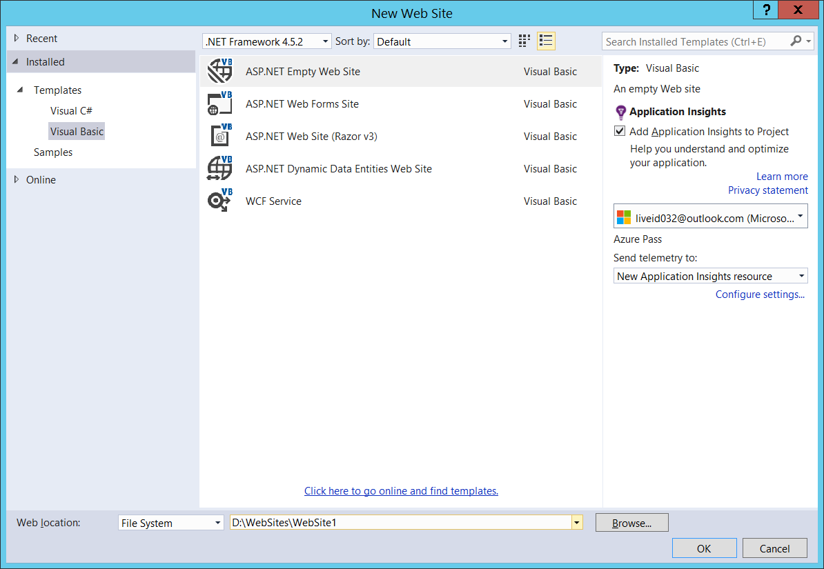
Publishing a web app from Visual Studio
Notes:
Consider demonstrating the process of using Visual Studio to create and publish a web app. If you decide to do this, you can publish the web app that you created in the previous demonstration.
10979D
4: Web Apps and cloud services

Slide 55
Performing staged deployments
Deploy updates by using:
FTP
Web Deploy
Continuous deployment:
Connect a project to a web app in Azure
Check in the changes
Build and deploy automatically to a staging slot
Swap to the production slot
Adjust (if needed):
Connection strings
Handler mappings
Monitoring and diagnostic settings
Notes:
Describe methods of deploying updates and performing continuous deployment.
10979D
4: Web Apps and cloud services

Slide 56
Update Web Apps with Minimal Downtime
Deployment Slots are live apps with their own hostnames
Only available for Standard or Premium App Service plans
Number of slots available depend on App Service Plan
App content and configurations can be swapped between two deployment slots
Not all settings and configurations are swapped
Some settings can be marked to not swap
Testing in Production feature allows you to spread traffic across multiple deployment slots
Notes:
Update Azure Web Apps with Minimal Downtime
Set up staging environments in Azure App Service
https://docs.microsoft.com/en-us/azure/app-service-web/web-sites-staged-publishing

Slide 57
What gets Swapped with a Deployment Slot?
Swapped | Not Swapped
App Settings – can be configured to not swap | Custom Domain Names
Connection Strings – can be configured to not swap | SSL certificates and bindings
General settings | Scale settings (only production slots are scalable)
Handler mappings | Publishing endpoints
Diagnostic logs settings

Slide 58
Monitoring web apps
Monitor Azure web apps:
Adding metrics
Configuring alerts
Configure diagnostics:
Web server logging
Detailed error messages
Failed request tracing
Application logging
Store logs:
File system
Azure storage
Notes:
Consider demonstrating the Metric blade in the Azure portal as you present this topic.
10979D
4: Web Apps and cloud services

Slide 59
https://github.com/MicrosoftLearning/10979-MicrosoftAzureFundamentals/blob/master/Instructions/10979D_LAB_04.md
Exercise 1
Estimated Time: 15 minutes

Slide 60
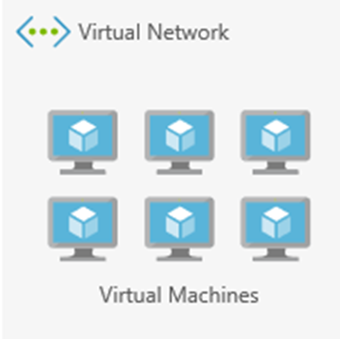
Virtual Networks

Slide 61
Virtual networks
What are virtual networks? Determine the need for virtual networks Virtual network capabilities
Creating and configuring Azure virtual networks Demonstration: Creating a virtual network Azure networking features
Overview of Azure Load Balancer Creating an Azure load balancer Demonstration: Creating an Azure load balancer
Notes:
10979D
5: Creating and configuring virtual networks

Slide 62
What are virtual networks?
Logical network boundary
Provided as a managed service:
Automatic routing
Built-in DNS name resolution
Support for customization
Private IP address space
Divided into one or more IP subnets
Notes:
10979D
5: Creating and configuring virtual networks

Slide 63
Determine the need for virtual networks
Deployment types:
Cloud-only deployments
Cross-premises deployments
Deployments without virtual network dependency
Virtual networks and Microsoft cloud resources:
Azure VMs (ARM) – must reside on a virtual network
Azure cloud services and Azure VMs (classic) – can reside on a virtual network
Azure Web apps – can connect to a virtual network via P2S VPN
Azure SQL Database, Azure AD – no direct connectivity to a virtual network
Notes:
Review different deployment types in the context of virtual network dependencies. Describe the most common Microsoft cloud resources and their integration (or lack thereof) with Azure virtual networks.
10979D
5: Creating and configuring virtual networks

Slide 64
Virtual network capabilities
IP address allocation:
Dynamic (default) — support for static IP address assignments
Traffic routing:
User defined routes and forced tunneling
Traffic filtering:
Network Security Groups
Notes:
Describe different capabilities available on Azure virtual networks.
10979D
5: Creating and configuring virtual networks

Slide 65
IP Addresses
Public and Private
4096 Private IP addresses per vnet
60 Dynamic Public IPs
20 Static Public IPs
Public IP addresses can be dynamic or static.
Dynamic IP address is not allocated until associated resource is created/started.
Dynamic IP Released when stop/delete resource.
Static IP address allocated immediately. Released only when it is deleted.
Use with
Virtual machines (VM)
Internet-facing load balancers
VPN gateways
Application gateway
Azure Datacenter IP Ranges: https://www.microsoft.com/en-us/download/details.aspx?id=41653
https://docs.microsoft.com/en-us/azure/virtual-network/virtual-network-ip-addresses-overview-arm#public-ip-addresses

Slide 66
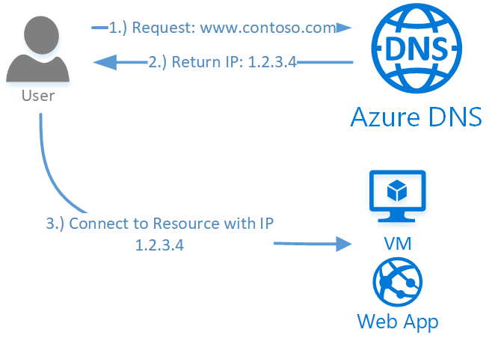
DNS name resolution
Azure Service for managing Public DNS (99.99% SLA)
Integrates with Azure Management Services
Controlled with Role Based Access Control
100 DNS Zones per subscription
5000 Record sets per zone
20 Records per record set
https://docs.microsoft.com/en-us/azure/dns/dns-overview

Slide 67
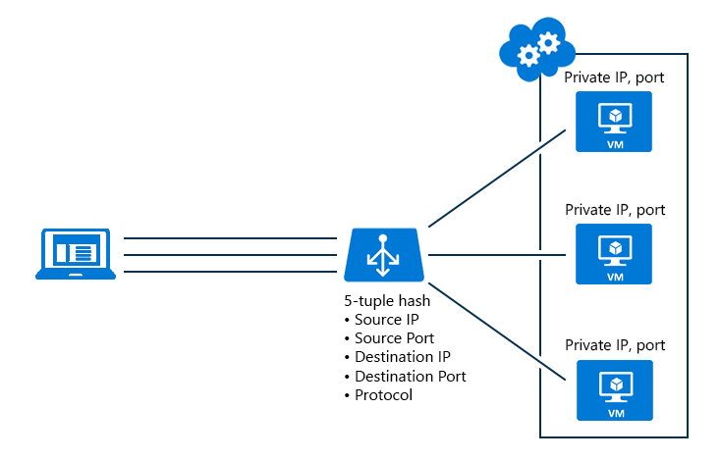
Load balancing
Notes:
Internal and External
10979D
5: Creating and configuring virtual networks

Slide 68
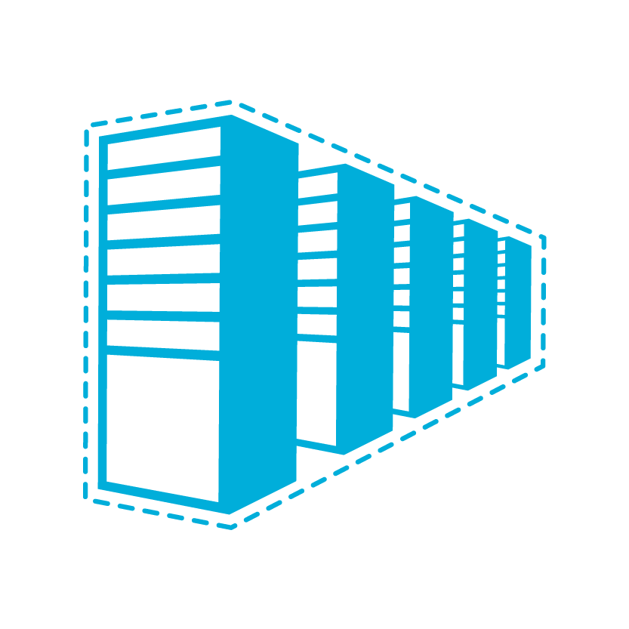


Virtual network connectivity
Cloud
Customer
Segment and workloads
Consumers
Access over public IP
DNS resolution
Connect from anywhere
Internet Connectivity
Developers
POC Efforts
Small scale deployments
Connect from anywhere
Secure point-to-site connectivity
SMB, Enterprises
Connect to Azure compute
Secure site-to-site
VPN connectivity
SMB & Enterprises
Mission critical workloads
Backup/DR, media, HPC
Connect to Microsoft services
ExpressRoute private connectivity
Notes:
Virtual network connectivity:
Cross-premises: P2S VPN, S2S VPN, ExpressRoute
Cross-VNet – VNet peering, VNet-to-VNet

Slide 69
Creating and configuring Azure virtual networks
Private IP address space:
Standard IP address ranges (RFC 1918):
10.x.x.x
172.16.x.x – 172.31.x.x
192.168.x.x
Avoid overlap with on-premises and other Azure virtual networks
IP Subnets:
The smallest supported size is /29
Use them to separate groups of virtual machines:
Security (Network Security Groups)
Individual tiers of multi-tier applications
Name resolution:
Azure DNS
Custom DNS
Notes:
Point out that Azure DNS in this case represents the Azure internally provided name resolution rather than the Azure DNS service.
10979D
5: Creating and configuring virtual networks

Slide 70
Creating a virtual network
Notes:
The main tasks for this exercise are as follows:
Create virtual networks by using Azure Portal
Task 1: Create a virtual network by using the Azure portal
From MIA-CL1, start Microsoft Edge, go to http://portal.azure.com, and then, if prompted, sign in to the Azure portal as the Service Administrator of your Azure subscription.
From the Azure portal, create a new virtual network by using the following settings:
Name: labVNet1
Address space: 10.0.0.0/16
Subnet name: Subnet1
Subnet address range: 10.0.0.0/24
Subscription: Your Azure subscription
Resource group: Create new
New resource group name: 10979D05-LabRG01
Location: Azure data center where you can deploy Azure VMs, closest to the location of your classroom
Pin to dashboard: Select the checkbox
From the Azure portal, create a new virtual network by using the following settings:
Name: labVNet2
Address space: 10.1.0.0/16
Subnet name: Subnet1
Subnet address range: 10.1.0.0/24
Subscription: Your Azure subscription
Resource group: Use existing 10979D05-LabRG01
Location: Azure data center where you can deploy Azure VMs, closest to the location of your classroom
Pin to dashboard: Select the checkbox
Task 2: Configure VNet peering by using the Azure portal
In the Azure portal, navigate to the labVNet1 blade.
From the labVNet1 blade, create a VNet peering with the following settings:
Name: labVNet1-labVNet2
Deployment model: Resource manager
Subscription: Your Azure subscription
Virtual network: labVNet2
Allow virtual network access: Enabled.
Allow forwarded traffic: Disabled
Allow gateway transit: Disabled
Use remote gateways: Disabled
In the Azure portal, navigate to the labVNet2 blade.
From the labVNet2 blade, create a VNet peering with the following settings:
Name: labVNet2-labVNet1
Deployment model: Resource manager
Subscription: Your Azure subscription
Virtual network: labVNet1
Allow virtual network access: Enabled.
Allow forwarded traffic: Disabled
Allow gateway transit: Disabled
Use remote gateways: Disabled

Slide 71
Azure networking features
Public IP addresses
Traffic Manager:
DNS-based load balancing
Any public, DNS-resolvable endpoint:
Azure
On-premises
Third-party hosting providers
Four routing algorithms:
Performance
Failover
Weighted
Geographic
Notes:
Describe Azure networking features that do not depend directly on Azure virtual networks.
10979D
5: Creating and configuring virtual networks

Slide 72

Overview of Azure Load Balancer
443
LOAD BALANCER
443
443
443
VM
VM
VM
Notes:
The slide depicts an end-user computer located at the top of the slide connecting from the Internet via port 443 to a load balancer. Azure Load Balancer distributes incoming traffic across three virtual machines (located at the bottom of the slide) to the port 443. Point out that the load balancer directs the traffic to only one of the VMs if the connection parameters, such as source and target IP addresses and ports, remain the same.
10979D
5: Creating and configuring virtual networks

Slide 73
Creating an Azure load balancer
Frontend IP configuration
Assign frontend IP(s)
Configure backend pool
Create load balancing rules:
Name
Protocol
Port
Backend port
Backend pool
Probe
Session persistence
Idle timeout
Floating IP
Create Inbound NAT rules:
If needed
Inbound NAT rules
LB rules (IP/port mapping)
probes
probes
Backend pool
Notes:
Describe the components of an Azure load balancer.
10979D
5: Creating and configuring virtual networks

Slide 74
Creating an Azure load balancer
https://docs.microsoft.com/en-us/azure/load-balancer/load-balancer-get-started-ilb-arm-portal

Slide 75
https://github.com/MicrosoftLearning/10979-MicrosoftAzureFundamentals/blob/master/Instructions/10979D_LAB_05.md
Estimated Time: 30 minutes

Slide 76
Azure Storage

Slide 77
Planning storage
Storage as an Azure component Overview of Azure Storage Planning for standard Azure Storage Planning for Azure Premium Storage
Notes:
20533D
6: Planning and implementing storage, backup, and recovery services

Slide 78
Overview of Azure Storage
Storage types:
Blob storage. Containers for data blobs. The three types of blobs are:
Page blobs:
Optimized for random access
Azure virtual machine disk files
Block blobs:
Optimized for sequential access
Ideal for media and backups
Append blobs:
Optimized for append operations only
Ideal for logging
Table storage. Store for non-relational key/value entities
Queue storage. Temporary store for asynchronous exchange of messages
File storage. File sharing store through SMB 3.x and SMB 2.1
Notes:
Emphasize that a standard storage account represents a namespace that identifies a storage area, which can include blob, table, queue, and file storage for standard storage accounts. Point out that premium storage accounts allow for hosting page blobs only.
This lesson later compares the storage types that Azure Storage supports. The last topic of this lesson covers premium storage accounts in more detail.
20533D
6: Planning and implementing storage, backup, and recovery services

Slide 79
Planning for standard Azure Storage
Blob storage:
Block blobs - variable-sized blocks, optimized for large blobs
Page blob - 512-byte pages, optimized for random read/write
Append blob - specifically for append operations
Table storage:
Stores data as key/value pairs in rows
Row entities or 252 custom properties (columns)
Single clustered index
Queue storage:
Stores inter-application messages
File storage:
SMB 2.1 and SMB 3.x file shares
Notes:
This slide describes the basic capabilities of each storage type:
Blobs:
Use block blobs for applications that need to upload large files to Azure. Block blobs are optimized for fast uploads and high throughput.
Use page blocks for applications that need to read and write data by using random I/O access patterns. For example, Azure VMs use page blobs as their virtual disks.
Tables:
Use tables as a NoSQL store for key/value pair records.
Queues:
Use queues to implement applications that need to exchange asynchronously messages among its components.
Note: Many application developers use the Azure Service Bus service instead of Azure Queue storage.
Files:
Use the Azure File Service to create file shares in Azure storage that users can access by using standard Server Message Block (SMB) semantics from VMs in Azure and from on-premises locations via a site-to-site virtual private network (VPN) or ExpressRoute.
20533D
6: Planning and implementing storage, backup, and recovery services

Slide 80
Planning for Azure Premium Storage
DS or GS virtual machine
Blobcache
RAM cache
Server SSD cache
Azure storage page blobs
Notes:
Point out the main differences between standard and premium storage accounts. In addition note that with Premium Storage, you pay for provisioned capacity rather than used capacity. With standard storage, you pay for used capacity except for scenarios that involve the use of managed disks. Mention that Premium Storage does not incur separate charges for transactional volume.
20533D
6: Planning and implementing storage, backup, and recovery services

Slide 81
Implementing and managing Azure Storage
Creating a storage account Implementing blobs Implementing Azure file storage Implementing Azure table and queue storage Controlling access to storage Monitoring storage Demonstration: Implementing storage
Notes:
20533D
6: Planning and implementing storage, backup, and recovery services

Slide 82
Creating a storage account
General purpose storage accounts:
Blobs (page, block, append), tables, queues, files
Performance
Standard or Premium (page blobs, LRS only)
Replication
LRS, ZRS (block blobs only), GRS, RA-GRS
Blob storage accounts:
Block and append blobs only (optimized pricing)
Access tiers (depending on frequency of data access):
Hot or cool
Switching between tiers is supported (consider cost implications)
Replication:
LRS, GRS, RA-GRS
Notes:
Describe the different types of accounts and their characteristics.
20533D
6: Planning and implementing storage, backup, and recovery services

Slide 83
Implementing blobs
Create a container in a storage account
Specify an access level:
Private
Public Blob
Public Container
Manage by using:
AzCopy
Azure Storage Explorer
Azure PowerShell
Azure CLI
Azure portal
Notes:
Describe the different methods of managing blobs and containers.
20533D
6: Planning and implementing storage, backup, and recovery services

Slide 84
Implementing Azure file storage
Creating file shares:
Azure portal, Windows PowerShell, Azure CLI, or REST API
Accessing file shares:
On Windows, create a drive mapping with the net use
On Linux, create a mountpoint and run mount –t cifs
Provide an account name and a key
Run from the same region (SMB 2.1 or SMB 3.x)
Run from another Azure region or from any on-premises location (SMB 3.x on Windows)
Alternatively, use Windows PowerShell, Azure CLI, AzCopy, or the REST API from any location
Notes:
Describe how to manage and access file shares.
20533D
6: Planning and implementing storage, backup, and recovery services

Slide 85
Implementing Azure table and queue storage
Create and update programmatically
Manage by using:
Azure Storage Explorer
Azure portal
Azure PowerShell and Azure CLI:
Tables:
Queues:
New-AzureStorageTable –Name $tabName –Context $context
Get-AzureStorageTable –Name $tabName –Context $context
Remove-AzureStorageTable –Name $tabName –Context $context
New-AzureStorageQueue –Name $qName –Context $context
Get-AzureStorageQueue –Name $qName –Context $context
Remove-AzureStorageQueue –Name $qName –Context $context
Notes:
Describe how to manage tables and queues.
20533D
6: Planning and implementing storage, backup, and recovery services

Slide 86
Controlling access to storage
Storage account access keys:
Primary and secondary
Automatically generated but can be recycled
Provide full access to a storage account
SAS:
Granular (container or resource level)
Time-limited
Stored access policy:
Granular (container level)
Time-limited
You can easily revoke policy-linked SAS
Role-based access control:
Default roles
Custom roles
Notes:
Point out that you can use a combination of access control mechanisms.
Note that shared access signatures that do not rely on a shared access policy typically are known as ad hoc shared access signatures.
20533D
6: Planning and implementing storage, backup, and recovery services

Slide 87
Monitoring storage
You can enable monitoring for a new or existing standard storage account:
Aggregate metrics
Per-API metrics
Logs
Not supported for Azure Premium storage accounts
Metrics and logs are stored in the same storage account
Metrics can be displayed in the Monitoring lens
Metric-based alerts:
Delivered through email
Routed to a Webhook
Notes:
Describe the process of configuring and viewing diagnostics of Azure Storage accounts.
20533D
6: Planning and implementing storage, backup, and recovery services

Slide 88
Implementing storage
Create a storage account
Use Windows PowerShell to upload blobs
View blob storage in Visual Studio
Configure monitoring and logging
View logged events
Notes:
You must perform these tasks to prepare the lab environment for the demonstrations in this module.
Have the students perform the steps with you so that the lab environment is also correctly configured for the lab in this module.
This course relies on custom Azure PowerShell modules including Add-20533DEnvironment to prepare the lab environment for demos and labs, and Remove-20533DEnvironment to perform clean-up tasks at the end of the module. The modules reside in E:\Modules on the 20533D-MIA-CL1 virtual machine.
Important: Note that the Remove-20533DEnvironment script will delete the Azure subscription resources that you provisioned when running Add-20533DEnvironment.
Preparation Steps
Start the MSL-TMG1 and 20533D-MIA-CL1 virtual machines, and then sign in to 20533D-MIA-CL1 as Student with the password Pa55w.rd. You should have provisioned a Microsoft Azure subscription ahead of time.
Demonstration Steps
Prepare the Azure environment
On the taskbar, right-click Windows PowerShell, and then click Run as administrator. In the User Account Control dialog box, click Yes.
Type the following command, and then press Enter:
Add-20533DEnvironment
At the prompt, type the module number, and then press Enter.
Confirm your selection, and then press Enter.
Note: This script might affect existing Azure services in your subscription. We recommend that you use an Azure subscription that was provisioned specifically for this course.
Preparation Steps
Before starting this demonstration, ensure that you have performed the “Preparing the environment” demonstration tasks at the beginning of the first lesson in this module, and ensure that the setup script has completed.
Demonstration Steps
Create a storage account
Ensure that you are signed in to MIA-CL1 as Student with the password Pa55w.rd and that the setup script that you ran in the previous demonstration to prepare the environment has completed.
Start Microsoft Edge, and then browse to the Azure portal. When prompted, sign in by using the Microsoft account that is the Service Administrator of your Azure subscription.
Create a new storage account with the following settings:
Name: Enter a valid, unique name consisting of between 3 and 24 lower-case characters or digits.
Deployment model: Resource Manager
Account kind: General purpose
Performance: Standard
Storage service encryption: Disabled
Replication: Locally-redundant storage (LRS)
Storage service encryption: Disabled
Secure transfer required: Disabled

Slide 89
Notes:
Subscription: your Azure subscription name
Resource group: create a new resource group named 20533D0601-DemoRG
Location: select the same location you chose when running Add-20533DEnvironment at the beginning of this module.
Pin to dashboard: Clear the check box
Wait for the storage account to be provisioned.
In the newly created storage account, create a blob container named demo-container with the private access type.
Use the Azure portal to view the access keys for the storage account.
Leave the Microsoft Edge window open. You will use it later in this demonstration.
Use Windows PowerShell to upload blobs
Open the Upload-Blobs_20533D06.ps1 file in the D:\Demofiles\Mod06 folder in Windows PowerShell Interactive Scripting Environment (ISE).
From within Windows PowerShell ISE, sign in to your Azure subscription.
In the script, set the value of the $storageAccountName variable to the name of the Azure storage account that you created in the previous task.
(More notes on the next slide)
20533D
6: Planning and implementing storage, backup, and recovery services

Slide 90
Notes:
Review the script, noting that it:
Declares a variable named $containerName that references the demo-container container that you created in the previous task.
Finds the folder where the script is stored and declares a variable named $sourceFolder that references the data subfolder.
Uses the Get-AzureRmStorageAccountKey cmdlet to retrieve the access key for your storage account.
Uses the New-AzureStorageContext cmdlet to create a storage context to allow for connectivity to your storage account by using one of two access keys.
Iterates through the files in the source folder and uses the Set-AzureStorageBlobContent cmdlet to write each file as a blob in the container.
Run the script and monitor its output, showing that the three files in the D:\Demofiles\Mod06\data folder uploaded the demo-container container in your storage account.
Close Windows PowerShell ISE without saving any changes.
View blob storage in Visual Studio
Start Microsoft Visual Studio and then, from its interface, connect to your Azure subscription by using Server Explorer.
From Server Explorer in the Visual Studio interface, view the demo-container blob container that you created earlier in this demonstration. Verify that the container has the files that the Windows PowerShell script uploaded in the previous task.
Close Visual Studio.
(More notes on the next slide)
20533D
6: Planning and implementing storage, backup, and recovery services

Slide 91
Azure Database
Primary
Sync Commit
Secondary
Secondary
Azure SQL DB

Slide 92
Database as-a-Service
Read/Write
Long Term Retention
Read
Primary
Azure Backup
Readable Secondary
Reports
Applications
Sync Commit
Async Commit
Secondary
Secondary
Azure SQL DB
Secondary
Azure SQL Database
Built-in local high availability with 99.99% SLA
Automatic backups (full, differential, trans log) with optional long term retention
Active geo-replication enables read replicas in a secondary region with a single DNS endpoint
Elastic Database Pools enables resource shared for more efficient cost management
Azure offers this managed service for SQL Server, MySQL, PostgreSQL

Slide 93
Azure SQL DB Tiers
 | Basic | Standard | Premium | Premium RS
Target workload | Development and production | Development and production | Development and production | Workload that can tolerate data loss up to 5-minutes due to service failures
Uptime SLA | 99.99% | 99.99% | 99.99% | N/A while in preview
Backup retention | 7 days | 35 days | 35 days | 35 days
CPU | Low | Low, Medium, High | Medium, High | Medium
IO throughput | Low | Medium | Order of magnitude higher than Standard | Same as Premium
IO latency | Higher than Premium | Higher than Premium | Lower than Basic and Standard | Same as Premium
Columnstore indexing and in-memory OLTP | N/A | N/A | Supported | Supported

Slide 94
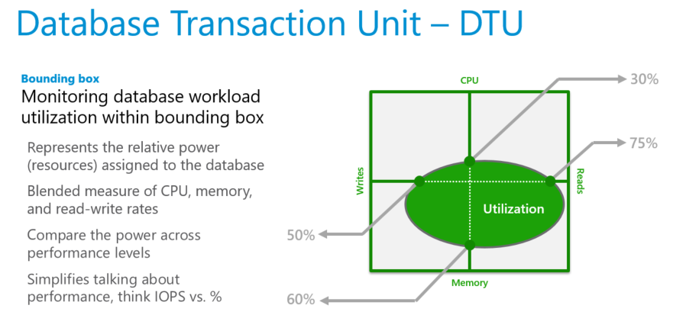
Choosing DB Performance Level
DTU Calculator

Slide 95
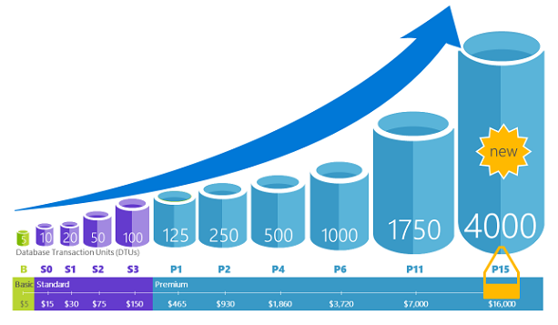
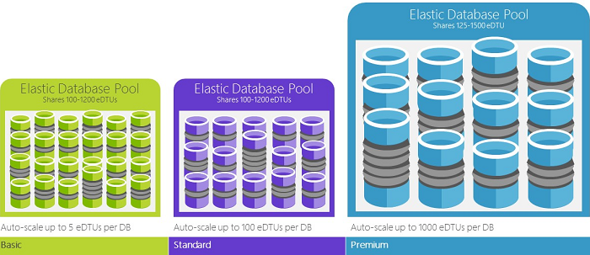
Database Types
Single Databases
Elastic Database Pools
Fully managed redundancy, backups, and upgrades
Wide range of sizes and performance tiers
Majority of feature parity with SQL Server
A shared pool of eDTUs by multiple DBs enables cost efficiency
Auto-scale within set parameters
Simplified management of large number of DBs
Adjust eDTUs for the pool as needed with no down time

Slide 96
Performance Level and Storage Size Limits
Single Databases
 | Basic | Standard | Premium | Premium RS
Maximum storage size* | 2 GB | 1 TB | 4 TB | 1 TB
Maximum DTUs | 5 | 3000 | 4000 | 100
Elastic Pools
 | Basic | Standard | Premium | Premium RS
Maximum storage size per database* | 2 GB | 1 TB | 1 TB | 1 TB
Maximum storage size per pool* | 156 GB | 4 TB | 4 TB | 1 TB
Maximum eDTUs per database | 5 | 3000 | 4000 | 1000
Maximum eDTUs per pool | 1600 | 3000 | 4000 | 1000
Maximum number of databases per pool | 500 | 500 | 100 | 100

Slide 97
SQL DB Security
Connectivity:
All connections are over a public endpoint and require TLS encryption for data in transit
Firewall rules limit connectivity by originating IP range
Service endpoints with an Azure VNET allow direct connectivity
Authentication:
SQL Authentication
Azure AD Authentication
Authorization:
Account database role and object level permissions
Impersonation
Row-level security
Data masking
Stored procedures
Security:
Transparent Database Encryption (TDE) using Microsoft or customer managed keys
Cell-level encryption to encrypt specific columns or cells of data
Always Encrypted for data in use
SQL database auditing to maintain regulator compliance

Slide 98
SQL DB Availability
Long-term data retention: Use Azure Backup to retain beyond 7-35 day window
Active Geo-Replication: Replicate an asynchronous (readable) secondary to another region
Failover Groups: Automatic failover of active geo-replicated secondary's using VIPs
Capability | Basic tier | Standard tier | Premium tier
Point in Time Restore from backup | Any restore point within 7 days | Any restore point within 35 days | Any restore point within 35 days
Geo-restore from geo-replicated backups | ERT < 12h, RPO < 1h | ERT < 12h, RPO < 1h | ERT < 12h, RPO < 1h
Restore from Azure Backup Vault | ERT < 12h, RPO < 1 wk | ERT < 12h, RPO < 1 wk | ERT < 12h, RPO < 1 wk
Active geo-replication | ERT < 30s, RPO < 5s | ERT < 30s, RPO < 5s | ERT < 30s, RPO < 5s

Slide 99
Active Directory in Azure

Slide 100
Overview of Azure AD
What is AD DS? Implementing AD DS in Azure Overview of Azure AD Active Directory synchronization and Azure AD Demonstration: Creating and managing an Azure AD tenant AD FS and Azure AD
Notes:
10979D
8: Creating and managing Azure AD

Slide 101
What is AD DS?
Serves as a core infrastructure component
Authenticates and authorizes domain users, computers, and Active Directory–aware applications
Stores management data that you can use to control user and computer settings by using Group Policy Objects (GPOs)
Relies on a secure channel with domain member computers established through domain join
Organizes objects into a customizable hierarchy
Extends the scope of authentication and authorization by using forests and trust relationships
Notes:
Depending on the students’ familiarity with AD DS, you might need to expand on some technologies that this topic presents. Make this presentation as interactive as possible, to help you determine whether students need additional clarification. Additionally, you should explain that while this module’s purpose is to focus on Azure AD, it is helpful to understand its on-premises origins. Understanding Active Directory also is helpful, as it eliminates confusion about the differences between AD DS (on-premises) and Azure AD (cloud).
10979D
8: Creating and managing Azure AD

Slide 102
Implementing AD DS in Azure
AD DS was designed for on-premises deployments:
Single-tenant by design
Relies on protocols not suited for Internet communication
Requires domain-joined computers to deliver full functionality
You can install AD DS domain controllers in Azure virtual machines to:
Utilize an AD DS domain that you manage
Utilize a separate AD DS or your on-premises AD DS
You can implement Azure AD DS to:
Utilize a separate AD DS domain that is a managed service
Synchronize with Azure AD and, optionally, with on-premises AD DS
You can leverage AD DS to authenticate and authorize mobile devices and cloud-based services
Notes:
Describe the two primary options for implementing AD DS in Azure, AD DS in Azure virtual machines, and Azure AD DS.
10979D
8: Creating and managing Azure AD

Slide 103
Overview of Azure AD
Microsoft-managed
A platform as a service offering:
Three service and pricing tiers (Free, Basic, Premium P1 and P2)
Multi-tenant by design
Relies on Internet-friendly protocols
Supports users, groups, applications, and devices
No organizational units or computer objects
Does not support Group Policy-based management:
Consider using an MDM solution (such as Microsoft Intune)
No support for forests or trust relationships:
Relies on federations to extend scope of authentication
Notes:
Note: This topic has two slides.
Students might find some of the concepts in this topic difficult to understand, so make this presentation as interactive as possible to determine whether you need to provide additional explanation. Focus on comparing AD DS and Azure AD, but start by briefly reviewing Azure subscriptions and accounts to ensure that students do not confuse them with Azure AD tenants and the corresponding Domain Name System (DNS) domains.
If students have Office 365 experience, they might be familiar with cloud, synchronized, and federated identities. Point out that this module focuses on authentication and authorization of cloud identities.
Mention that Azure AD is capable of authenticating and authorizing access to both cloud-based and on-premises applications.
Describe the four authentication options that Azure AD provides:
Implementing authentication exclusively in Azure AD.
Maintaining an on-premises authoritative source of the identity data in AD DS but synchronizing it to Azure AD at regular intervals.
Taking advantage of Active Directory Federation Services (AD FS) capabilities (which this topic covered earlier) to authenticate users accessing cloud resources.
Relying on pass-through authentication.
10979D
8: Creating and managing Azure AD

Slide 104
Overview of Azure AD
Delegation model within Azure AD tenant:
Several predefined Azure AD roles
Permissions based on users, groups, and applications
Assigned applications automatically accessible via Access Panel
Delegation model within Azure AD subscription:
Role-based access control (RBAC) using Azure AD principals
Predefined and custom roles
Roles assigned on the resource, resource group, or subscription level
Native support for Multi-Factor Authentication
Azure AD identity types:
Cloud identity
Synchronized identity
Federated identity
Notes:
10979D
8: Creating and managing Azure AD

Slide 105
Active Directory synchronization and Azure AD
Directory synchronization tool (AAD Connect) synchronizes objects between AD DS and Azure AD
Password hash synchronization and pass-through authentication with Seamless Single Sign-On minimize password related issues
Federated users scenario:
Uses an STS (For example, AD FS) to perform authentication
Eliminates password related issues (SSO)
Azure AD
AAD Connect Server
Notes:
Describe the four scenarios for using the Azure AD Connect. Most implementations of Azure AD that integrate with an on-premises AD DS use directory synchronization. Directory synchronization significantly reduces the management overhead required to integrate on-premises AD DS with Azure AD.
10979D
8: Creating and managing Azure AD

Slide 106
Creating and managing an Azure AD tenant
Create an Azure AD tenant, assign to it a custom domain, and view the verification DNS records
Associate an Azure AD instance with the current Azure subscription
Create an Azure AD user account
Grant an Azure AD user administrative access to an Azure subscription
Notes:
Review the steps in Lab A for guidance when performing this demonstration.
https://github.com/MicrosoftLearning/10979-MicrosoftAzureFundamentals/blob/master/Instructions/10979D_LAB_08.md

Slide 107
AD FS and Azure AD
AD DS domain controller
6
Federation trust
AD FS
Azure AD
7
10
4
5
9
3
8
2
SaaS application
Client computer
1
11
Notes:
Describe the process of authenticating access to an Azure AD–integrated software as a service (SaaS) application by a federated user.
This is an animation slide with 11 clicks.
The first click depicts the user opening a web browser and sending an HTTPS request to the SaaS application.
The second click depicts the SaaS application determining that the user belongs to an Azure AD tenant. The SaaS application provider redirects the user to the user’s Azure AD tenant.
The third click depicts the user’s browser sending an HTTPS authentication request to the Azure AD tenant.
The fourth click depicts that, if the user’s Azure AD account represents a federated identity, the user’s browser is redirected again to the on-premises federation server.
The fifth click depicts the user’s browser sending an HTTPS request to the on-premises federation server.
The sixth click depicts that, if the user is signed in to the on-premises AD DS domain, the federation server requests the AD DS authentication based on the user’s existing Kerberos ticket. Otherwise, the user is prompted to authenticate with the on-premises AD DS credentials, which the federation server relays to an AD DS domain controller.
The seventh click depicts the AD DS domain controller verifying the authentication request and then sending the successful authentication message back to the federation server.
The eighth click depicts the federation server creating the claim for the user based on the rules defined as part of Active Directory Federation Services (AD FS) configuration. The claims data is placed in a digitally signed security token and forwarded to the user’s browser.
The ninth click depicts the user’s browser forwarding the security token containing claims to Azure AD.
10979D
8: Creating and managing Azure AD
(More notes on the next slide)

Slide 108
Notes:
The tenth click depicts Azure AD verifying the validity of the AD FS security token based on the existing federation trust. It creates a new token for the purpose of accessing the SaaS application and sends it back to the user’s browser.
The eleventh click depicts the user using the Azure AD–issued token to access the SaaS application.
10979D
8: Creating and managing Azure AD

Slide 109
Manage Azure AD authentication
Multi-Factor Authentication Demonstration: Configuring and using Multi-Factor Authentication SSO via Access Panel Demonstration: Configure Password-based SSO
Notes:
10979D
8: Creating and managing Azure AD

Slide 110


Multi-Factor Authentication
Azure Multi-Factor Authentication adds a second level of authentication:
Text message
Phone call
Mobile app
Notes:
Provide the following details to expand the students’ understanding of this topic. By default, Azure AD relies on passwords for user authentication. Microsoft Azure Multi-Factor Authentication adds an extra level of authentication, requiring users to use a text message, a call to an office, a mobile phone, or a smart phone app. You cannot configure Multi-Factor Authentication for users who are using Microsoft accounts.
The range of Multi-Factor Authentication capabilities depends on the Azure AD tier. The capabilities described in this topic are part of the Azure Free tier:
Ability to enable and enforce Multi-Factor Authentication for users who are Global Admins. Multi-Factor Authentication for end users is not supported as part of Azure AD Free tier.
Use of text messages, calls to an office and mobile phone, or a mobile phone app as a second authentication factor.
Support for app passwords for desktop apps.
Default voice messages during verification phone calls.
Azure AD Premium includes additional Multi-Factor Authentication features, such as:
Ability to enable and enforce Multi-Factor Authentication for all Azure AD user accounts.
Azure AD–based Multi-Factor Authentication services to protect on-premises infrastructure and applications, including Active Directory Federation Services (AD FS), Remote Access Server (RAS), or Internet Information Services (IIS)-based apps.
One-time bypass allowing for skipping Multi-Factor Authentication for a single sign in to address legitimate emergencies when users do not have their phones readily available but need to sign in to their apps.
Blocking and unblocking of users, temporarily denying their ability to authenticate via Multi-Factor Authentication.
Customizable caller ID, identifying the number from which verification calls are made.
10979D
8: Creating and managing Azure AD
(More notes on the next slide)

Slide 111
Notes:
Advanced reporting and alerting in the form of security reports and fraud alerts. The alerts allow users to notify their administrators whenever they receive an unauthorized authentication verification call.
Customizable voice messages during verification phone calls.
10979D
8: Creating and managing Azure AD

Slide 112
Configuring and using Multi-Factor Authentication
Enable Multi-Factor Authentication for an Azure AD user account
Authenticate to the Azure portal as an Azure AD user with Multi-Factor Authentication enabled
http://aka.ms/E9ep7z

Slide 113
SSO via Access Panel
Single Sign-On implementations:
Password-based SSO:
Administrator managed credentials
User managed credentials
Azure AD SSO
Linked SSO
Azure AD Access Panel:
Lists all applications assigned to a user
Implements SSO
Relies on Access Panel Extension browser add-on for password-based SSO
Notes:
Point out that the use of password-based single SSO applications from Access Panel requires installation of the Access Panel Extension add-on and enabling it in the browser. Such extensions are available for newer versions of Internet Explorer (starting with Internet Explorer 8), Chrome, and Firefox. Opening an application for the first time triggers its installation.
10979D
8: Creating and managing Azure AD

Slide 114
Configure Password-based SSO
Add a directory application
Assign a directory application to a user
http://aka.ms/R8gc5q

Slide 115
https://github.com/MicrosoftLearning/10979-MicrosoftAzureFundamentals/blob/master/Instructions/10979D_LAB_08.md
Estimated Time: 30 minutes

